Slide 1



110th VitrA Data Science Bootcamp Pharma Sales Prediction Project
Project Group Members:
Erkan Çetinyamaç
Yağmur Uzun
Arda Can Baysar
Eren Kaya
Melike Demirdağ

Slide 2


Business Understanding
Feature Engineering
Data Pre-Processing
Conclusion
Data
Understanding
Data Visualization
Modelling

Slide 3

Business Understanding
Since predicting to future sales holds crucial importance for a company to decide how to take action about production and purchasing operations, it is vital to build a model to predict next sale amounts in order to company can benefit from this significant intel.
Our project group aims to build a model that can predict next sale amounts.

Slide 4

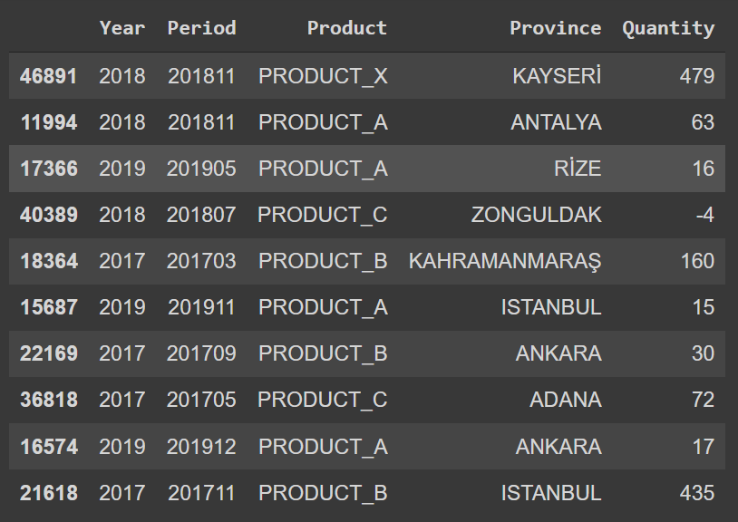
Data Understanding
Product:
Product A : Chronic Gastroenterology, Sales volume proportional to the number of patients.
Product B : Acute: Painkiller.
Product C : Acute : Digestive System, for children 0-4 years old.
Product V : Vitamin.
Product X : Chronic: Urology, Patient group with a high average age.
Period and Year Features: Dates for the sales.
Province: The city information that product was sold.
Quantity: The number of drug that was sold.
Fig. 1 – Raw Data

Slide 5

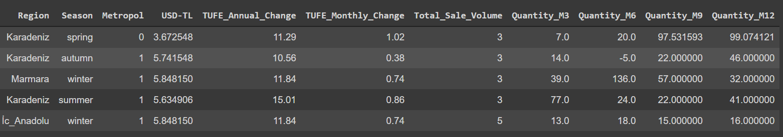
Feature Engineering
Fig. 2 – New Features
Web Page of the Data Source:
https://www.tcmb.goconnect/TR/TCMB+TR/Main+Menu/Istatistikler/Enflasyon+Verileri/Tuketici+Fiyatlariv.tr/wps/wcm/
https://www.tcmb.gov.tr/wps/wcm/connect/tr/tcmb+tr/main+menu/istatistikler/doviz+kurlari/reel+efektif+doviz+kuruu

Slide 6
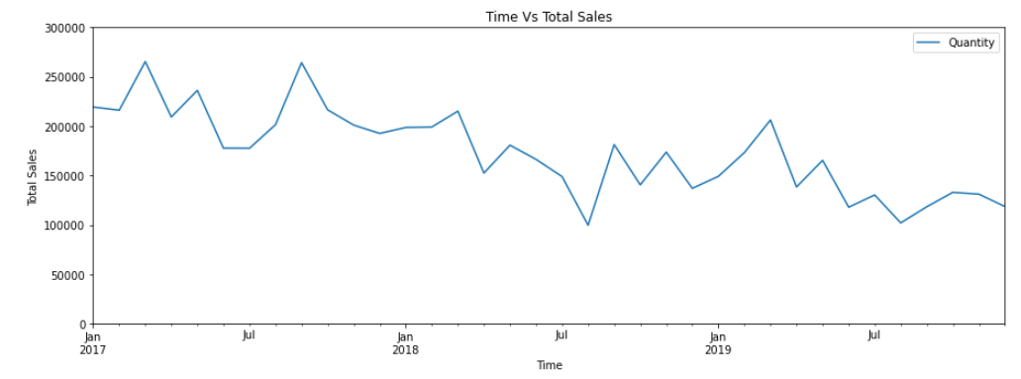
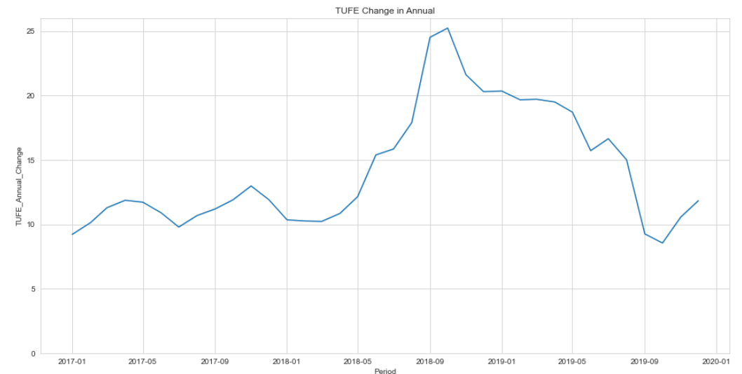
Graph - Total Quantity and TUFE Annual Change
Fig. 3 – Total Quantity vs Time Line Plot
Fig. 4 – Annual TUFE Change vs Time Line Plot

Slide 7
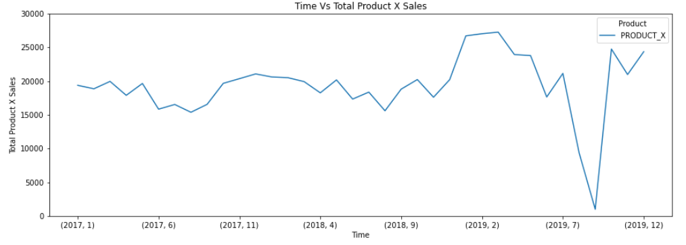
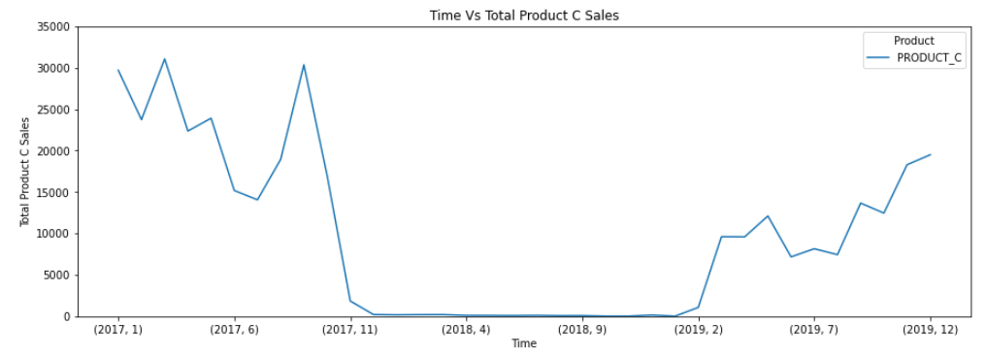
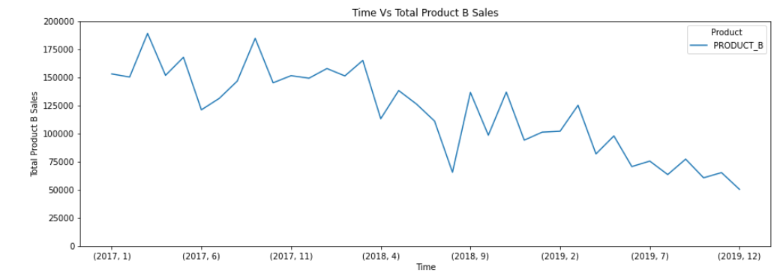
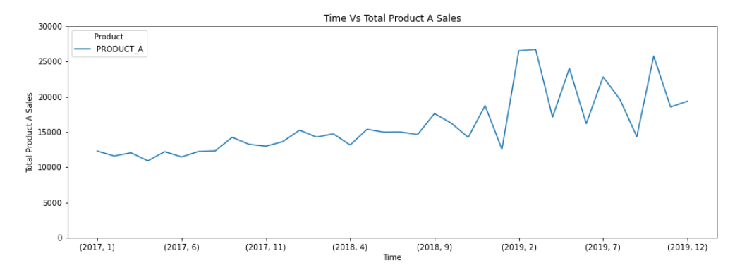
Graph - Product vs Time
Fig. 5, 6, 7, 8 – Product Types vs Time

Slide 8
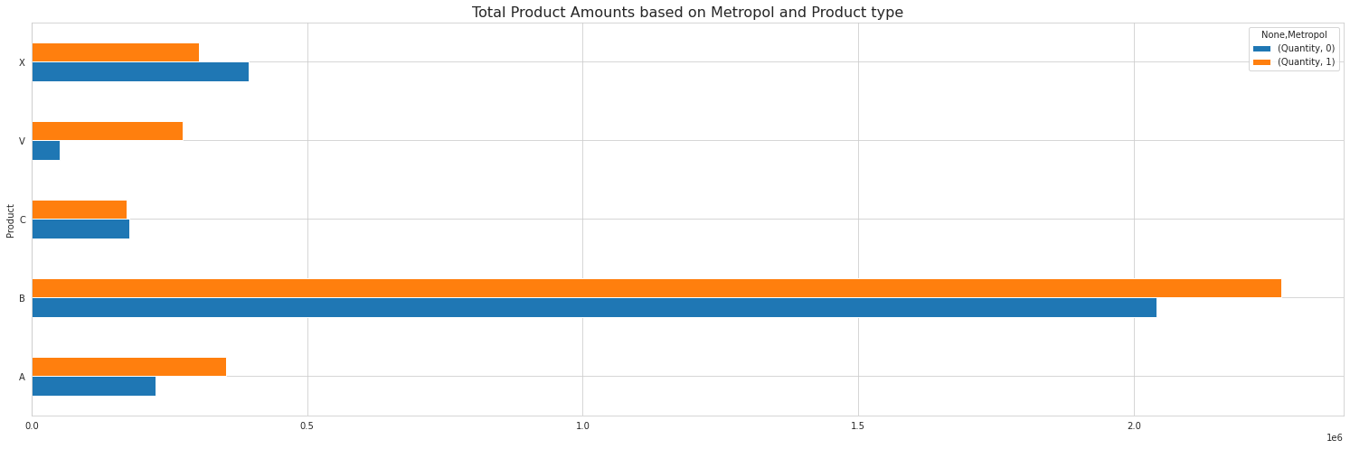
Graph - Metropol vs Anadolu Product Sales Comparison
Fig. 9 – Product Sales of Metropol and Anadolu Comparison Bar Plot

Slide 9
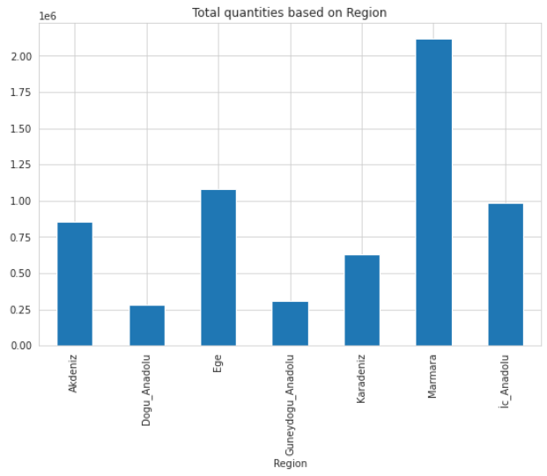
Graph - Sales With Respect To Regions
Fig. 10 – Total Sales vs Regions Bar Plot

Slide 10
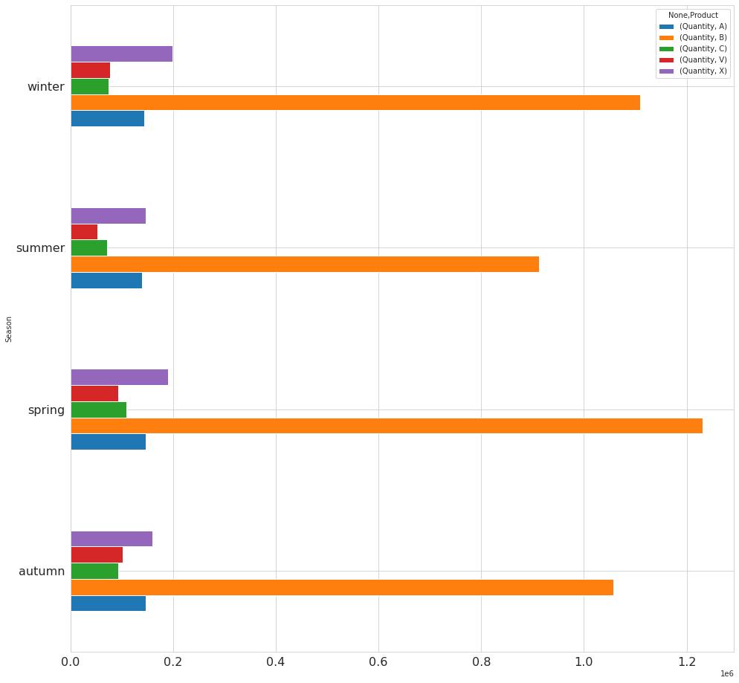
Graph - Product Sale Quantities vs Season
Fig. 11 – Sale Quantities vs Season Bar Plot

Slide 11
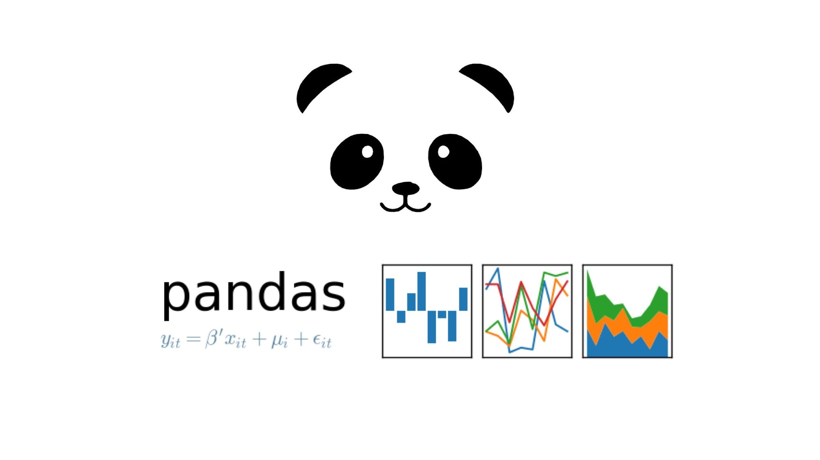




Libraries

Slide 12
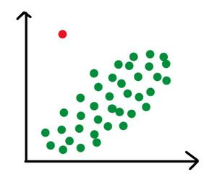
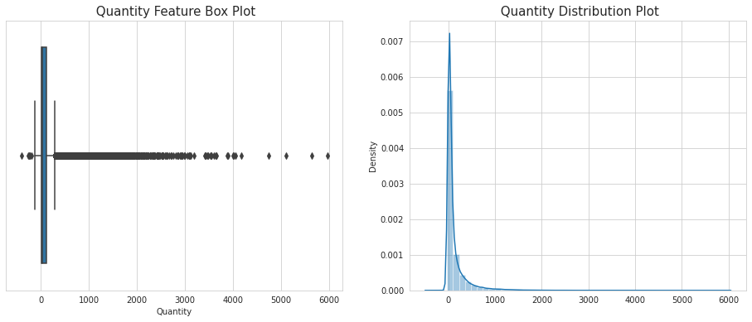
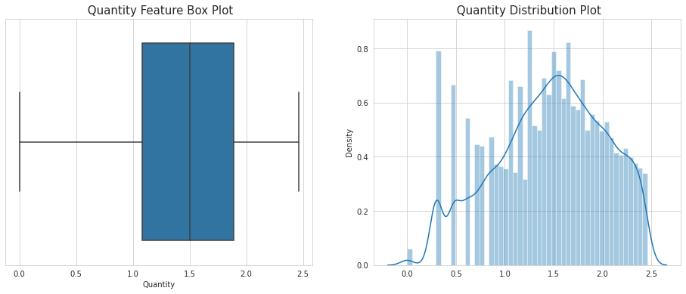
Pre-Processing
Target feature 'Quantity' is highly skewed and has many outliers in it. Also since minus values of quantity feature that represents refund information therefore we should deal with them before building ML models by log10 transforming the target and IQR Method for outlier elimination.
Before the Process
After the Process
Fig. 12 – Outliers and Skewness Before the Process
Fig. 13 – Outliers and Skewness After the Process

Slide 13

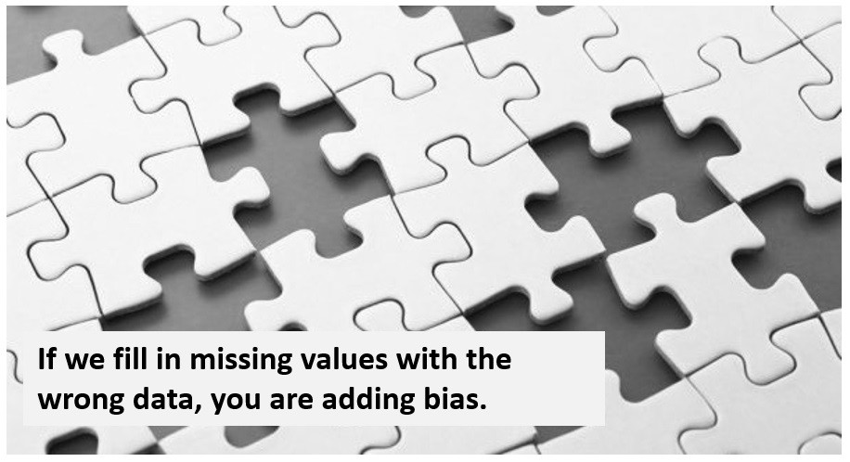
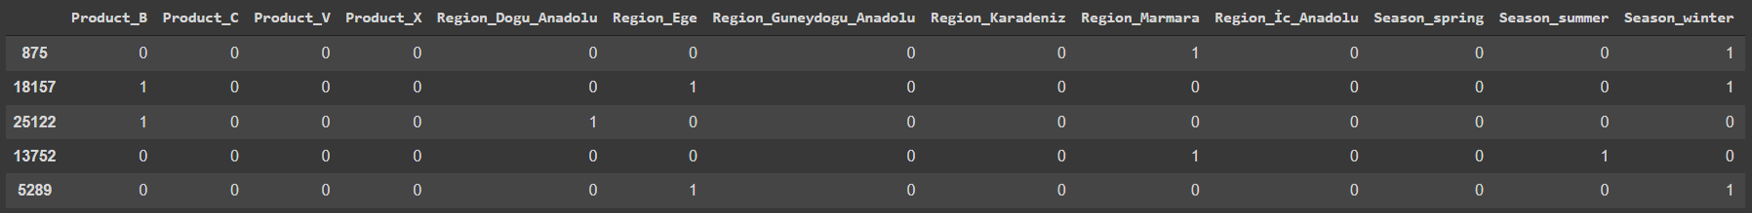
Pre-Processing
Due to creating new features using by ‘Quantity’ column we got NA values in the ‘Quantity’ feature which was not originally in the data. We thought that since the target feature is right skewed, imputing NA values with mean is more logical choice than imputing median here.
The categorical features that are ‘Product’, ’Region’, ’Season’ are encoded with dummy encoding method.
Fig. 14 – Dummy Encoding to Categorical Features

Slide 14



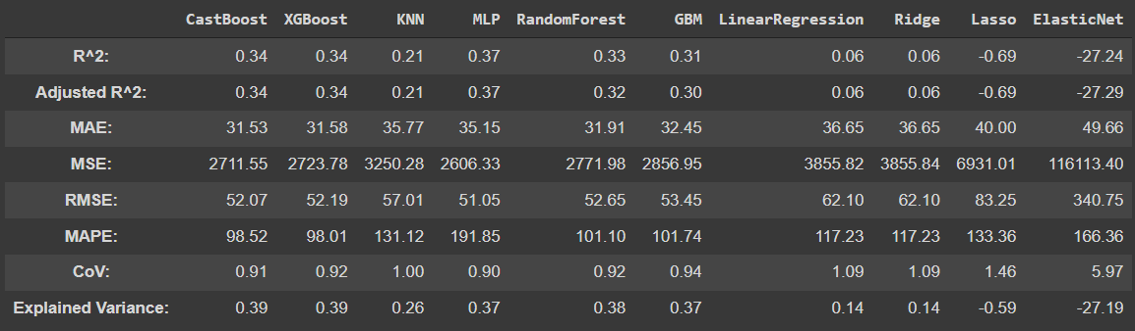
Model Building and Comparison
Split with respect to the date.
Split with respect to sample.
Fig. 15 – Regression Models Comparison Table

Slide 15

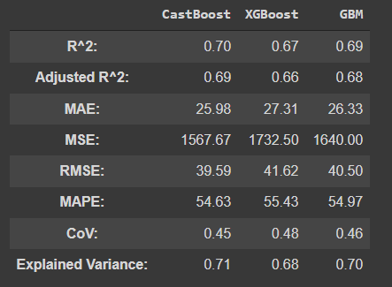
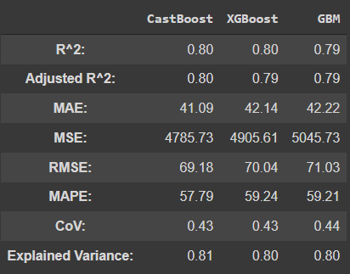
Model Building For Each Product
After the GridSearchCV and Model tuning process, the models that below returns slightly better scores compared to other regression models for predicting only the product X quantity amount.
Testing The Previous Model With Only Product X Test Data
Testing New Trained Model For Only Product X Data
Fig. 16 –Previous Model’s Evaluation Metrics For Product X Test Data
Fig. 17 – Evaluation Metrics For the Trained Model With Only Product X

Slide 16


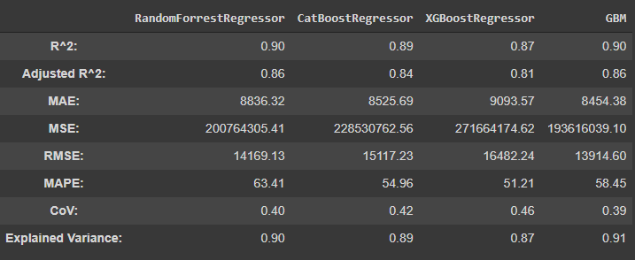
Grouping by the Month and Predicting Monthly Total Sales of All Products
Fig. 18 – Hyperparameter Tuned Model Comparison Table

Slide 17

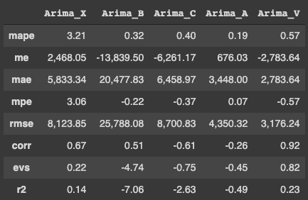
Time Series Analysis with ARIMA
We used Univariate Time Series Forecasting to predict sales by using arima package in python. Sales quantities were grouped by month then processed.
Best model parameters for product V: ARIMA(4,1,0)(1,1,0)[12]
Fig. 19 – Error Metrics for Arima Predictions

Slide 18

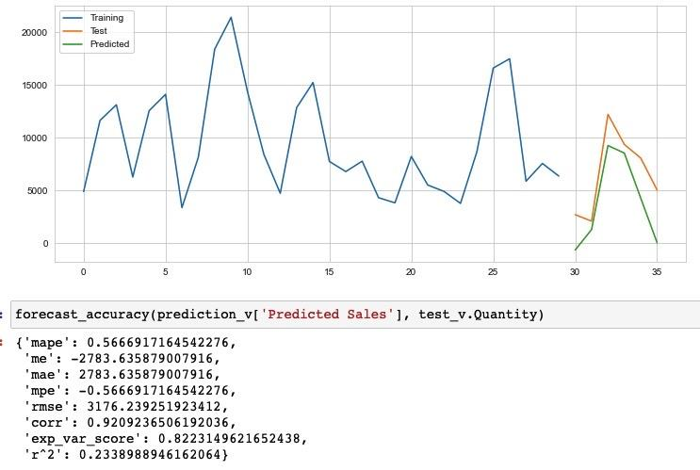
Time Series Analysis with ARIMA
Best prediction performance is achieved for Product V.
Fig. 20 – Train, Test and Prediction Plot for Arima

Slide 19


Conclusion
Model for all product at once
Models for each product
Model for all product after group by period and aggregate sum of quantity
Time series analysis( ARIMA) for each product
We achieved the best prediction performance with grouping by month for all products.

Slide 20


To-Do List
The next steps would be;
Grouping the data by Province and make prediction.
Building a separate model for high sale volume products.
And building another model for low sale volume products
Local and Global explainability with SHAP library.

Slide 21


THANK YOU FOR YOUR ATTENTION!

